Slide 1

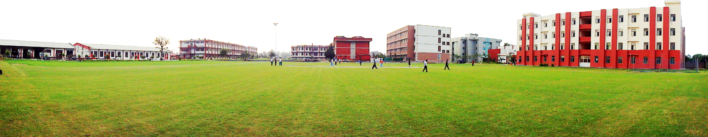
Operating System
Lecture by:
Rajesh Pandey
Create by:- Vivek shrivastav
Shobhit Institute of Engineering & Technology
[ NAAC “A” Grade Accredited, Deemed to be University ]
adv

Slide 2

Introduction to OS
Definition
An Operating System (OS) is a crucial piece of system software that manages computer hardware and software resources and provides common services for computer programs. It acts as an intermediary between users and the computer hardware, enabling the execution of applications in a convenient and efficient manner.
Key Functions of an Operating System
Resource Management: The OS allocates and manages resources such as memory, CPU time, and input/output devices among various programs and processes.
Process Management: It handles the creation, scheduling, and termination of processes, ensuring efficient execution and resource allocation.
Memory Management: The OS manages the computer's primary memory, optimizing its usage and ensuring that each process has sufficient memory.
Shobhit Institute of Engineering and Technology (NAAC 'A' Grade Deemed to be University)

Slide 3
Introduction to OS
File Management: It organizes and manages files and directories, providing mechanisms for file creation, deletion, and manipulation.
Security: The OS implements security policies and mechanisms to protect data and resources from unauthorized access. ( Authorization/Authentication, firewall etc)
Device Management: It manages input/output devices, providing necessary drivers and interfaces for communication between devices and the computer. (Plug and Play, Disk Scheduling, print pooler service etc)
Networking: The OS provides networking capabilities, enabling the establishment and management of network connections and resource sharing. (NIC, Wi-Fi adapter and modem)
User Interface: It offers a user interface, such as a Graphical User Interface (GUI) or Command-Line Interface (CLI), for user interaction with the system.
Shobhit Institute of Engineering and Technology (NAAC 'A' Grade Deemed to be University)

Slide 4
Generations of OS
The evolution of operating systems has been marked by significant technological advancements and changes in user needs. Here are some key points in the evolution of operating systems:
Batch Processing: Early computers were operated without operating system. Programs were manually loaded and run, one at a time. The first operating systems were batch processing systems GM-NAA I/O introduced in 1956 that automated job handling.
Multiprogramming and Timesharing: Introduction of multiprogramming to utilize CPU efficiently and allowed timesharing systems like CTSS (1961) and Multics (1969) for multiple user interaction.
Unix Revolution: Unix (1971) revolutionized OS design with its simplicity, portability, and multitasking capabilities.
Personal Computers: The emergence of personal computers led to simpler OSs like CP/M (1974) and PC-DOS (1981).
Shobhit Institute of Engineering and Technology (NAAC 'A' Grade Deemed to be University)

Slide 5
Generations of OS
Graphical User Interfaces: GUIs gained popularity with systems like Apple Macintosh (1984) and Microsoft Windows (1985).
Networking Features: TCP/IP in Unix became essential, and Linux (1991) introduced open-source development.
Mobile OSs: Windows and Mac OS refined GUIs and gained widespread adoption.
AI Features: Modern operating systems have integrated AI features like voice commands (Siri, Google Assistant and Alexa etc), Predictive text, and personalized recommendations.
Shobhit Institute of Engineering and Technology (NAAC 'A' Grade Deemed to be University)

Slide 6
Types of Operating System
Operating systems (OS) can be classified into several types based on their structure, usage and interaction with hardware and users.
Batch Operating Systems Batch operating systems execute batches of similar jobs without user interaction during processing. Jobs are collected, grouped, and processed sequentially. Early mainframe computers commonly used this type. Examples include IBM OS/360.
Time-Sharing (Multitasking) Operating Systems
Timesharing operating systems allow multiple users to interact with the computer simultaneously. The CPU time is divided into small slices and allocated to each task in turn, giving the illusion of parallelism. Examples include UNIX, Linux, and Windows.
Distributed Operating Systems
Distributed operating systems manage a collection of independent computers and present them as a single coherent system to users. They allow resource sharing and parallel processing across multiple machines. Examples include Plan 9, Amoeba.
Shobhit Institute of Engineering and Technology (NAAC 'A' Grade Deemed to be University)

Slide 7
Types of Operating System
Real-Time Operating Systems (RTOS)
Real-Time operating systems are designed to respond to input or events within a strict time constraint. They are used in environments where timing is critical, such as embedded systems, robotics, and industrial control. Examples include VxWorks, QNX, and RTLinux.
Network Operating Systems
Network operating systems provide features to manage network resources and allow computers to communicate over a network. These systems manage file sharing, printer access, and security across interconnected systems. Examples include Windows Server, Novell NetWare.
Mobile Operating Systems
Mobile operating systems are specially designed for smartphones, tablets, and other portable devices. They are optimized for smaller hardware and touch based interfaces. Examples include Android, iOS, and HarmonyOS.
Shobhit Institute of Engineering and Technology (NAAC 'A' Grade Deemed to be University)

Slide 8
Types of Operating System
Multiuser and Single-User Operating Systems
Multiuser OS allows multiple users to simultaneously access system resources, common in servers and mainframes. Single user OS is designed for direct usage by one person at a time, typical for personal computers.
Embedded Operating Systems
Embedded operating systems are tailored for specific hardware and limited resources, usually in appliances, IoT devices, or cars. They are often lightweight and efficient. Examples include FreeRTOS, Embedded Linux.
Shobhit Institute of Engineering and Technology (NAAC 'A' Grade Deemed to be University)

Slide 9
Components of Operating System
Most OS share the following common functional components.
Process Management Handles the creation, scheduling, execution, suspension, and termination of processes. It allocates CPU time, manages inter-process communication (IPC) via shared memory or message passing, and ensures synchronization to avoid race conditions or deadlocks.
File Management Provides long-term storage through files and directories. It supports file creation, deletion, reading, writing, and organization in hierarchical structures. The OS abstracts physical storage details and enforces file protection and access control.
Command Interpreter (Shell) Acts as the primary user interface for executing commands. It can be a CLI (e.g., Bash, Windows CMD) or GUI-based. Commands may be built-in or loaded from system files for execution.
System Calls Serve as the programming interface to OS services. They allow user programs to request operations like process control, file handling, memory allocation, and I/O operations without exposing hardware details.
Signals Software or hardware interrupts that notify processes of events (e.g., errors, completion).
Shobhit Institute of Engineering and Technology (NAAC 'A' Grade Deemed to be University)

Slide 10
Components of Operating System
I/O Device Management Abstracts hardware details, manages device drivers, and optimizes data transfer using buffering, caching, and spooling. It ensures efficient and error-free device operations.
Main Memory Management Tracks memory usage, allocates/deallocates space, and decides which processes to load. RAM is volatile and used for active program execution, requiring efficient utilization.
Secondary Storage Management Manages non-volatile storage like HDDs, SSDs, and optical media. Functions include free space tracking, storage allocation, and disk scheduling for optimal performance.
Network Management Administers network resources, ensuring connectivity, performance, and security. It supports distributed systems, resource sharing, and fault management.
Security Management Controls access to system resources, ensuring only authorized processes/users can operate on files, memory, or devices. Implements authentication, authorization, and protection mechanisms.
Shobhit Institute of Engineering and Technology (NAAC 'A' Grade Deemed to be University)

Slide 11
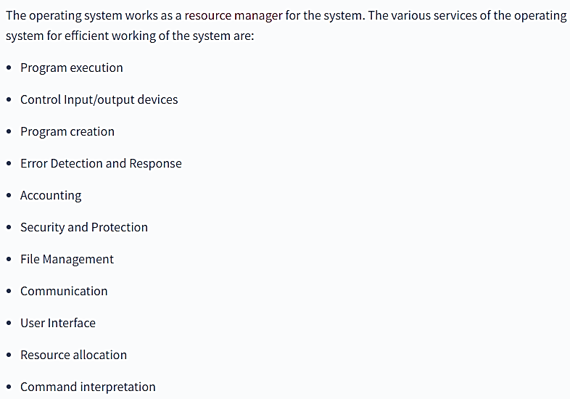
Services of Operating System
Shobhit Institute of Engineering and Technology (NAAC 'A' Grade Deemed to be University)

Slide 12
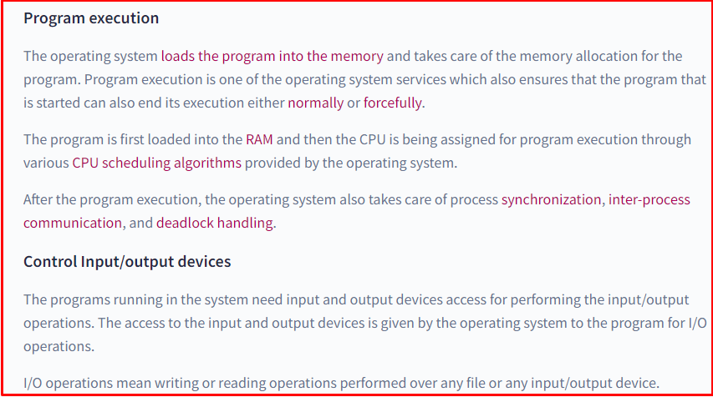
Services of Operating System
Shobhit Institute of Engineering and Technology (NAAC 'A' Grade Deemed to be University)

Slide 13
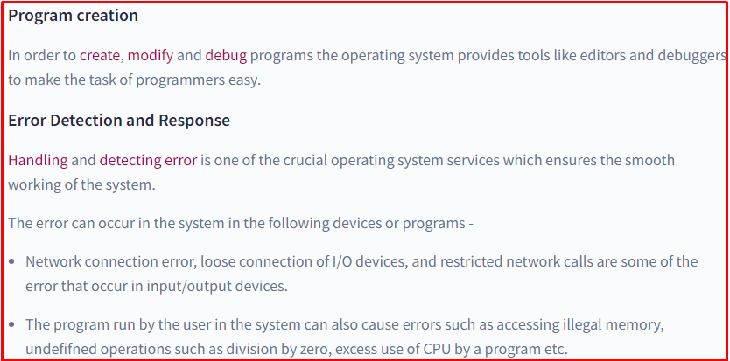
Services of Operating System
Shobhit Institute of Engineering and Technology (NAAC 'A' Grade Deemed to be University)

Slide 14
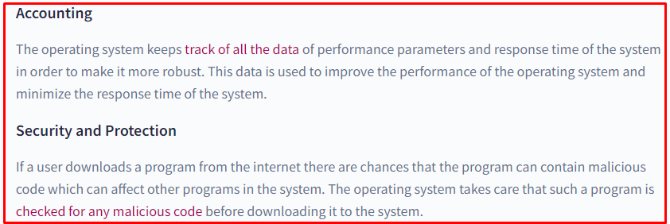
Services of Operating System
Shobhit Institute of Engineering and Technology (NAAC 'A' Grade Deemed to be University)

Slide 15
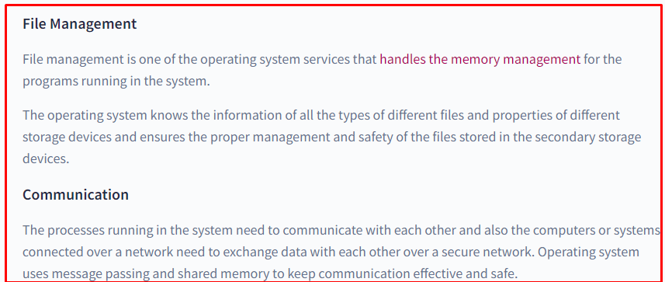
Services of Operating System
Shobhit Institute of Engineering and Technology (NAAC 'A' Grade Deemed to be University)

Slide 16
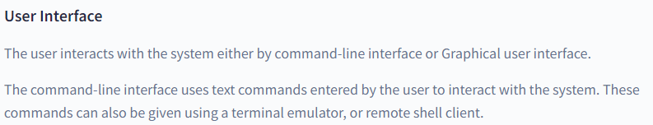
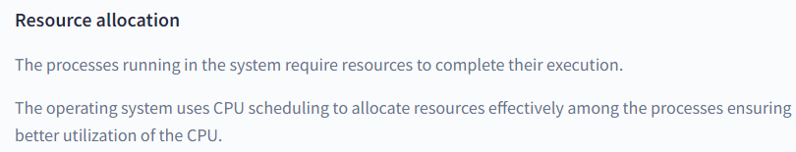
Services of Operating System
Shobhit Institute of Engineering and Technology (NAAC 'A' Grade Deemed to be University)

Slide 17
Structure of Operating System
Structure of operating system acts as a blueprint that shows how the OS is arranged so it can be understood and adapted to different needs. Following are various popular implementations of Operating System structures:
  Simple Structure
  Layered Structure
  Modular Structure
  Virtual Machines
  Monolith Structure
  Micro-Kernel Structure
  Hybrid-Kernel Structure
  Exo-Kernel Structure
Shobhit Institute of Engineering and Technology (NAAC 'A' Grade Deemed to be University)

Slide 18
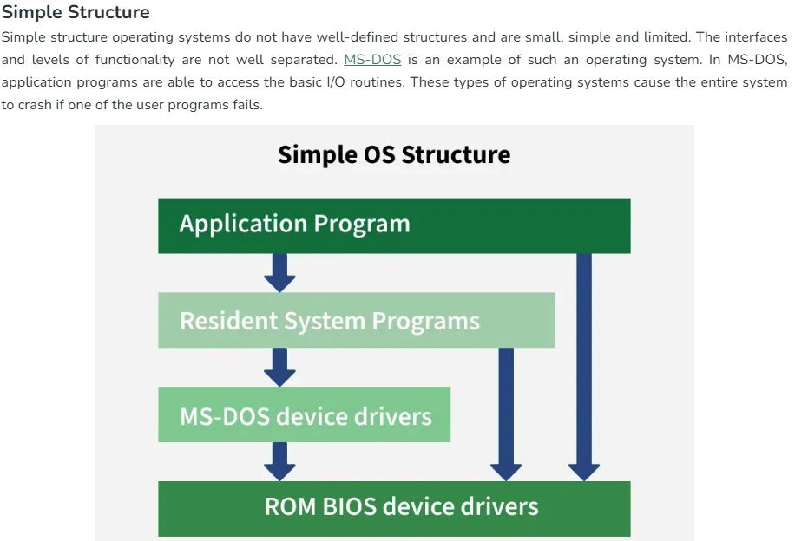
Structure of Operating System
1. Simple Structure:
  No well-defined structure; small and limited.
  Interfaces and functionality levels are not separated.
  MS-DOS is an example of this structure.
  Applications can directly access basic I/O routines.
  A user program failure can crash the entire system.
Shobhit Institute of Engineering and Technology (NAAC 'A' Grade Deemed to be University)

Slide 19
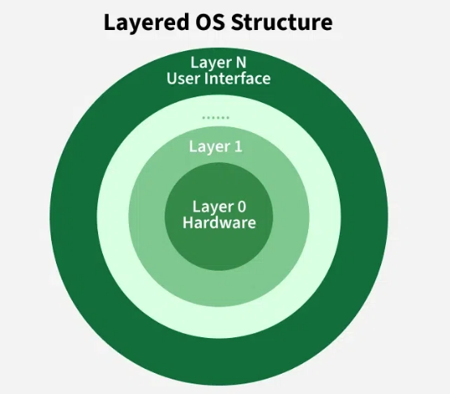
Structure of Operating System
2. Layered Structure
  OS is divided into multiple layers (hardware at bottom, UI at top).
  Each layer uses the functions of the layer below it.
  Easier debugging because errors are isolated to specific layers.
  Adds overhead due to data passing through many layers.
  Requires careful planning; layers can only use lower layers.
  UNIX is an example of a layered structure.
Shobhit Institute of Engineering and Technology (NAAC 'A' Grade Deemed to be University)

Slide 20
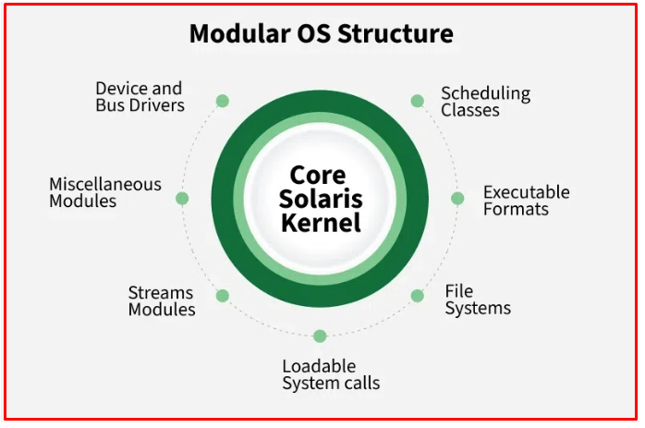
Structure of Operating System
3. Modular Structure
  Kernel contains only core components.
  Extra services are added as dynamically loadable modules.
  More flexible than layered structure; modules can call any other module.
  Used in systems like Solaris.
Shobhit Institute of Engineering and Technology (NAAC 'A' Grade Deemed to be University)

Slide 21
Structure of Operating System
4. Virtual Machine
  Each VM behaves like a separate, independent machine.
  VirtualBox is a common example of virtualization.
  CPU scheduling and virtual memory give each VM dedicated-like resources.
Shobhit Institute of Engineering and Technology (NAAC 'A' Grade Deemed to be University)

Slide 22
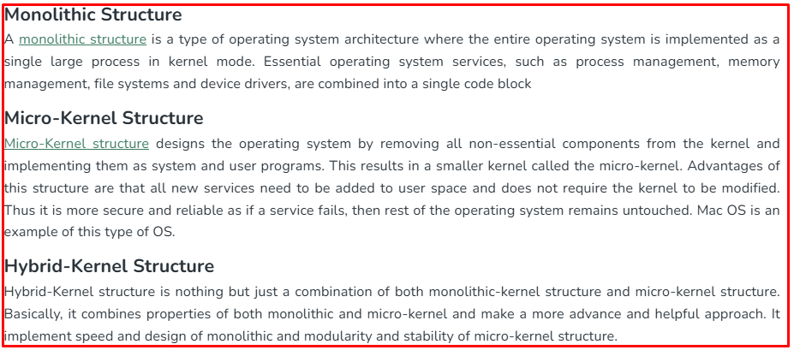
Structure of Operating System
Shobhit Institute of Engineering and Technology (NAAC 'A' Grade Deemed to be University)

Slide 23
Structure of Operating System
4. Exo-Kernel Structure
  Provides application-level control of hardware resources.
  Separates protection from resource management.
  Avoids enforcing OS abstractions to allow customization.
  Small, minimal design that offers greater developer freedom.
Shobhit Institute of Engineering and Technology (NAAC 'A' Grade Deemed to be University)

Slide 24
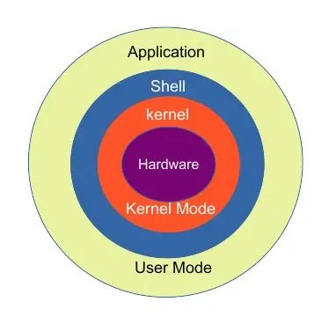
Architecture of Operating System
In operating system Architecture, we've two major terms which defines the major components of the operating systems.
Kernal − Kernal is the central component of an operating system which is responsible for all major operations and interaction with the hardware. A kernal manages memory, processor, input/output devices and provides interface to application programs to interact with hardware components.
Shell − Shell is an interface of an operating system. It can be command line interface or a graphical user interface. User interacts with an operating system using shell. Application programs can also use shell interface to interact with underlying operating system.
System Softwares − System softwares are the programs which interact with Kernal and provides interface for security managment, memory management and other low level activities.
Application Programs − Application softwares/Programs are the one using which a user interacts with the operating system. For example a word processor to create a document and save it on the file system, a notepad to create notes etc.
Shobhit Institute of Engineering and Technology (NAAC 'A' Grade Deemed to be University)

Slide 25
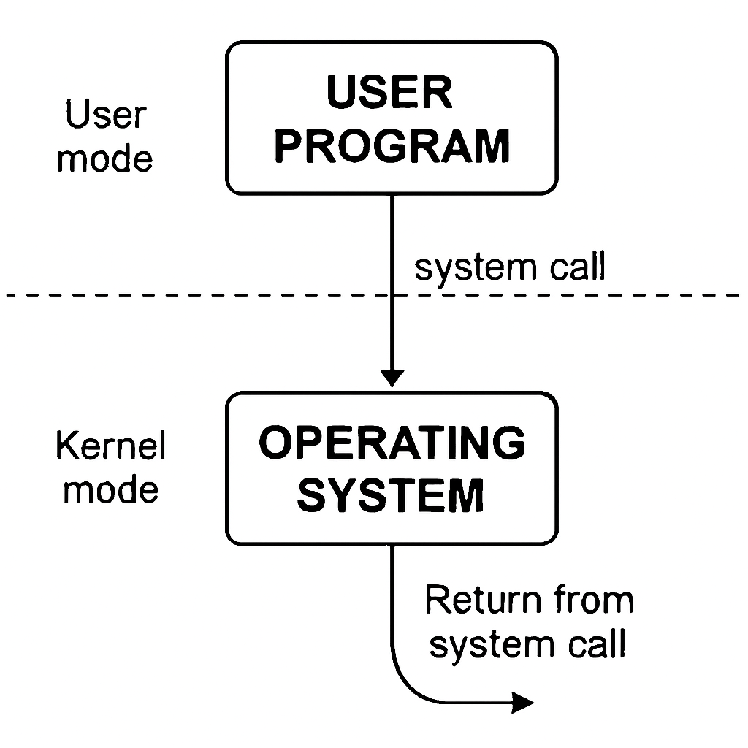
Systems Calls in Operating System
Definition: System calls are the interface between a user program and the operating system’s kernel. A system call is a mechanism that lets a program in user mode request services from the kernel mode of the operating. They allow user applications to request services like file handling, process management, memory allocation, and device communication in a safe, controlled way.
How System Calls Work
  A user program executes normally in user mode.
  When it needs OS services (e.g., reading a file), it issues a system call.
  The CPU switches to kernel mode to execute the requested service.
  Once completed, control returns to user mode and the program continues
Shobhit Institute of Engineering and Technology (NAAC 'A' Grade Deemed to be University)

Slide 26
Systems Calls in Operating System
Types of System Calls:
Type | Purpose | Examples
Process Control | Create, terminate, or manage processes | fork(), exec(), exit()
File Management | Handle files and directories | open(), read(), write(), close()
Device Management | Request or release device access | ioctl(), read(), write()
Information Maintenance | Get/set system data | getpid(), alarm(), time()
Communication | Enable inter-process communication | pipe(), shmget(), send(), recv()
Memory Management | Allocate/free memory | brk(), mmap()
Shobhit Institute of Engineering and Technology (NAAC 'A' Grade Deemed to be University)

Slide 27
Batch Operating System
Definition:
A batch operating system is a system that executes a series of jobs with similar needs collectively, or "in batches," to make efficient use of resources. Users submit jobs to the operating system, which are stored and processed according to a predefined schedule without manual intervention during the execution.
Characteristics:
Job Sequencing: Jobs are collected and executed in the order they are submitted.
No User Interaction: Users do not interact with the program during execution; input and output are handled automatically.
Offline Processing: Jobs are prepared on punch cards or magnetic tapes before processing.
Resource Utilization: Efficient CPU and I/O device usage by processing one batch continuously without waiting for user commands.
Single Task Processing at a Time: Typically one job runs at a time on the CPU, while other jobs wait in a queue.
Shobhit Institute of Engineering and Technology (NAAC 'A' Grade Deemed to be University)

Slide 28
Batch Operating System
Disadvantages:
  Delayed Output: Jobs may take a long time to produce results since they are queued.
  No Interaction: Users cannot communicate with jobs during execution.
  Error Handling Difficulty: Debugging is harder because errors are discovered after batch completion.
Advantages
  High CPU Utilization: Since jobs are organized, the CPU spends less idle time.
  Reduced Setup Time: Similar jobs processed in batches share setup procedures.
  Automation: Once jobs are submitted, no human intervention is needed.
Shobhit Institute of Engineering and Technology (NAAC 'A' Grade Deemed to be University)

Slide 29
Batch Operating System
Is Batch OS Still in Use ?
batch operating systems are still in use today, but not in the same way as in the 1950s–70s. They survive in specialized environments like mainframes, banking, insurance, scientific computing, and large-scale data processing, where jobs are grouped and executed without direct user interaction¹².
Why Batch OS Still Exists
Legacy Systems: Many banks, airlines, and government agencies still rely on mainframes running batch jobs (e.g., IBM OS/360, BS2000). Migrating these systems is costly and risky.
Efficiency: Batch processing is ideal for tasks that don’t need real-time interaction, such as payroll, billing, or end-of-day transaction reconciliation.
Big Data & Cloud: Modern batch concepts live on in frameworks like Hadoop MapReduce or Apache Spark, which process massive datasets in batches.
Shobhit Institute of Engineering and Technology (NAAC 'A' Grade Deemed to be University)

Slide 30
Batch Operating System
Where You’ll Find Batch OS Today:
Domain | Use Case
Banking & Finance | End-of-day transaction processing, payroll, interest calculations
Insurance | Claims processing, premium calculations
Airlines & Railways | Ticketing, scheduling, reservation systems
Scientific Computing | Large simulations, data analysis
Cloud/Data Platforms | Hadoop, Spark, AWS Batch — modern batch frameworks inspired by batch OS
Shobhit Institute of Engineering and Technology (NAAC 'A' Grade Deemed to be University)

Slide 31
Batch Operating System
Comparison: Past vs Present :
Notes : Batch OS is not obsolete — it has evolved. While you won’t find it on desktops, it remains critical in enterprise mainframes and modern big-data/cloud platforms
Aspect | Classic Batch OS (1950s–70s) | Modern Batch Systems (Today)
Interface | Punch cards, tape drives | Cloud dashboards, APIs
Use Case | Payroll, billing, scientific jobs | Big data analytics, cloud workloads
Technology | IBM OS/360, BS2000 | Hadoop, Spark, AWS Batch
Interaction | No user interaction | Automated scheduling, monitoring
Environment | Mainframes | Cloud clusters, distributed systems
Shobhit Institute of Engineering and Technology (NAAC 'A' Grade Deemed to be University)

Slide 32
Concepts of Multiprogramming and Time Sharing
An Operating System (OS) is the actual software (like Windows, Linux, macOS).
Multiprogramming and Time Sharing are design approaches or features that an OS can implement.
Multiprogramming:
  Multiple programs are loaded into memory at the same time.
  The CPU switches between them when one program is waiting (e.g., for I/O).
  Goal: maximize CPU utilization by keeping it busy.
Time Sharing:
  Extension of multiprogramming.
  CPU time is divided into small slices and shared among users/programs.
  Each user feels like they have their own computer.
  Goal: interactive use and fairness.
Shobhit Institute of Engineering and Technology (NAAC 'A' Grade Deemed to be University)

Slide 33
Concepts of Multiprogramming and Time Sharing
Comparison Table :
Note:
  Multiprogramming is about efficiency (keeping CPU busy).
  Time Sharing is about interaction and fairness (making systems feel responsive to multiple users).
Aspect | Multiprogramming | Time Sharing
Definition | Technique where multiple programs are kept in memory and the CPU switches among them when one is waiting. | Technique where CPU time is divided into small slices and shared among multiple users/programs.
Goal | Maximize CPU utilization (keep CPU busy). | Provide interactive response and fairness among users.
User Experience | Users may not directly interact; mainly for batch processing. | Each user feels like they have their own computer.
CPU Scheduling | CPU switches when a program is blocked (e.g., waiting for I/O). | CPU switches at regular intervals (time slices).
Response Time | Longer; not designed for immediate interaction. | Short; designed for interactive systems.
Example Systems | Early batch systems, IBM OS/360. | UNIX, modern interactive operating systems.
Shobhit Institute of Engineering and Technology (NAAC 'A' Grade Deemed to be University)

Slide 34
Concepts of Parallel and Distributed System
Parallel Systems
Definition: A parallel system is designed to divide a program into smaller fragments and execute them simultaneously across multiple processors.
Memory Model: Can be shared memory (all processors access the same memory) or distributed memory (each processor has its own local memory).
Goal: Increase computational speed and efficiency.
Examples: Multicore processors, supercomputers.
Key Point: Tight coupling — processors are closely linked and often share memory.
Shobhit Institute of Engineering and Technology (NAAC 'A' Grade Deemed to be University)

Slide 35
Concepts of Parallel and Distributed System
Distributed Systems
Definition: A distributed system consists of multiple autonomous computers connected by a communication network, working together as a single system.
Memory Model: Each computer has its own local memory and resources.
Goal: Resource sharing, fault tolerance, scalability, and collaboration across different machines.
Examples: Cloud computing platforms, LOCUS, MICROS distributed operating systems.
Key Point: Loose coupling — independent nodes communicate via a network.
Shobhit Institute of Engineering and Technology (NAAC 'A' Grade Deemed to be University)

Slide 36
Concepts of Parallel and Distributed System
Real-World Applications of Parallel Systems :
Parallel systems are used when speed and efficiency are critical.
Artificial Intelligence & Machine Learning: Training deep neural networks requires massive parallel computation across GPUs.
Scientific Research: Weather forecasting, molecular modeling, and physics simulations rely on parallel supercomputers.
Finance: High-frequency trading platforms use parallel systems to process millions of transactions per second.
Manufacturing & Engineering: CAD simulations and real-time robotics control leverage parallel processing for precision.
Big Data Analytics: Platforms like Apache Spark use parallelism to process huge datasets quickly.
Shobhit Institute of Engineering and Technology (NAAC 'A' Grade Deemed to be University)

Slide 37
Concepts of Parallel and Distributed System
Real-World Applications of Distributed Systems :
Distributed systems shine in scalability, fault tolerance, and global reach.
Search Engines (Google, Bing): Billions of queries are handled daily by distributed clusters of servers.
E-Commerce (Amazon, Flipkart): Distributed databases and microservices ensure reliability and fast response times.
Streaming Platforms (Netflix, YouTube): Content delivery networks (CDNs) distribute data across the globe for smooth playback.
Social Media (Facebook, Twitter): Distributed systems manage real-time messaging, feeds, and billions of user interactions.
Cloud Computing (AWS, Azure, Google Cloud): Virtual machines, storage, and services are distributed across data centers worldwide.
Distributed Databases: Systems like Apache Cassandra and MongoDB handle massive, geographically spread datasets
Shobhit Institute of Engineering and Technology (NAAC 'A' Grade Deemed to be University)

Slide 38
Concept of Real Time Operating System (RTOS)
A Real-Time OS ensures time-bound execution of processes, crucial for applications where delays can lead to system failure.
Types of RTOS
Hard RTOS
  Guarantees task completion within strict time limits .
  Missing a deadline is considered a system failure.
  Example: flight control systems
Soft RTOS
  Missing a deadline degrades performance but is not catastrophic
  Example: multimedia streaming
Shobhit Institute of Engineering and Technology (NAAC 'A' Grade Deemed to be University)

Slide 39
Concept of Real Time Operating System (RTOS)
Applications
  RTOS applications span areas where timing correctness is critical:
  Industrial automation systems
  Automotive ECU (engine control units) and anti-lock braking systems
  Robotics and drones control
  Medical devices like infusion pumps
  Telecommunications and networking systems
  Aerospace systems like satellites and aircraft navigation
Shobhit Institute of Engineering and Technology (NAAC 'A' Grade Deemed to be University)

